Slide 1
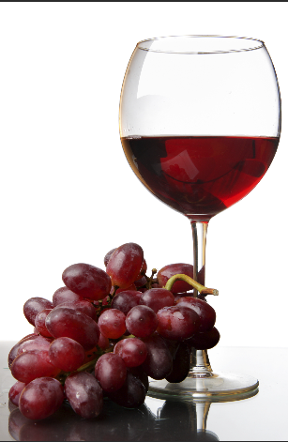
QUALITY OF RED-WINE PREDICTION

Slide 2
CONTENT:
PROBLEM STATEMENT
INTRODUCTION
IMPORTING PACKAGES
EXPLORATORY DATA ANALYSIS
DATA CLEANING
CLASSIFICATION

Slide 3
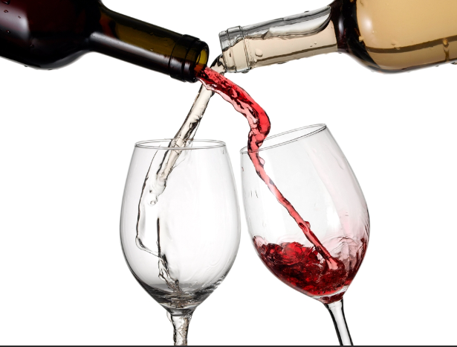
PROBLEM STATEMENT:
How the quality
of wine is being
predicted?

Slide 4

INTRODUCTION:
There are many people who consume
red-wine in foreign countries which
has many advantages as well
disadvantages.
For the Manufacturer in order to
predict the quality of red-wine, they
require some analysis.
This analysis can be done
by using machine learning
algorithms.

Slide 5
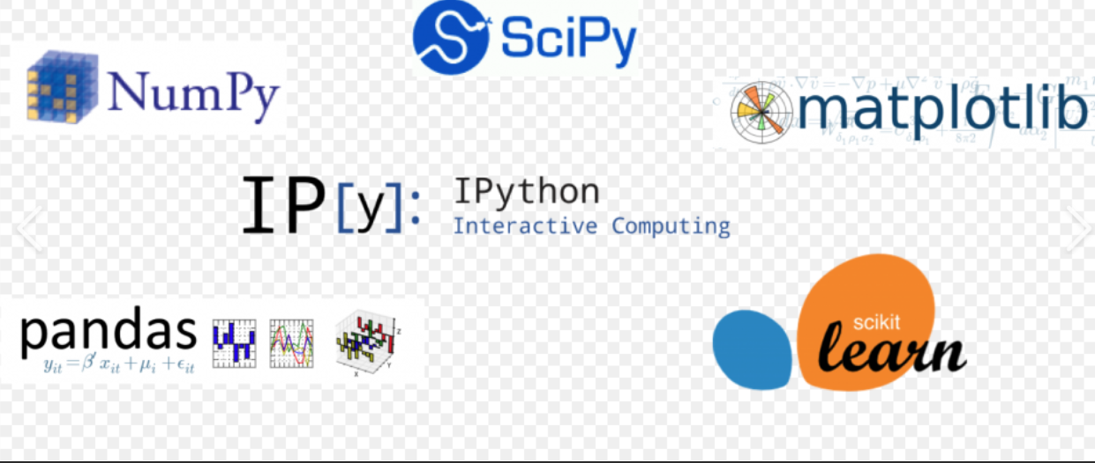
PACKAGES USED:

Slide 6
About Packages:
NUMPY: It is of course one of the greatest Mathematical and Scientific computing library for Python.
PANDAS: It is used for structured data operations, manipulations, used for demining and preparation .
MATPLOTLIB: It is used to plot variety of graphs like hist plots, box plots, etc….
SCIKIT LEARN :Simple and efficient tools for data mining and data analysis . Accessible to everybody, and reusable in various contexts .Built on NumPy, SciPy, and matplotlib Open source, commercially usable - BSD license
SEABORN : It is similar to matplotlib but adds more visualization to the graphs.

Slide 7
EXPLORATORY DATA ANALYSIS:
Supervised learning.
Total data(labels and features) are in numerical.
Label is numerical , so we can perform following to predict output Classification
For every quartile(Q1,Q2,Q3) the percentage has been increased for each and every feature.
There are no outliers in the data(the diff b/w min and max is too small).

Slide 8
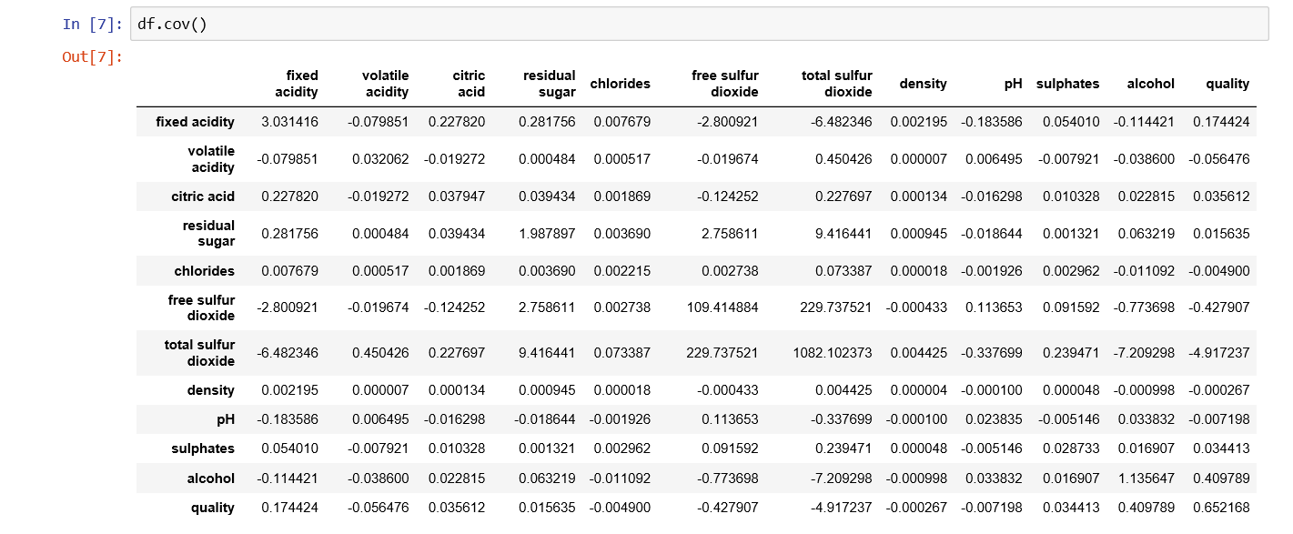
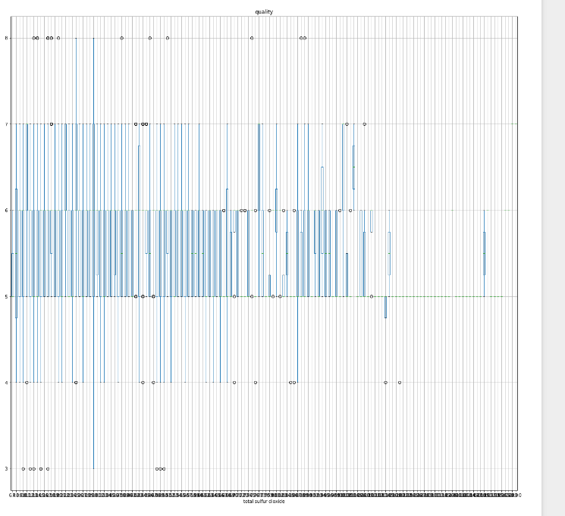
BOXPLOTS:
1.In all plots for (chance of admit vs features) the plots have been increased.
2. Overlires are too less in the plots.
3. As data is not too noisy all the quartiles are appeared.

Slide 9
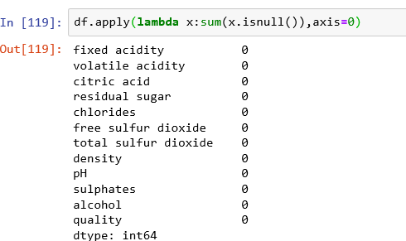
DATA CLEANING:
In order to perform data cleaning we should use LAMBDA function.
‘Lambda’ is a specialized function which can be used only once to check the missing values. It is a part of anonymous function.
Here we don’t require any data cleaning.

Slide 10
PREDICTIONS
Here the main features that predict the quality of wine are Volatile Acidity, Fixed Acidity, Citric Acid, Total Sulphur-di-oxide, Sulphates, Density and the label is Quality of wine.
Here the Quality of Wine is in the range of 3 to 8.
Here the pH value is in the permissible range of 3.3-3.5 what generally a Red wine has.
Here the Label has Non-Dicotomos values. So we can perform both linear regression and classification since the data is continuous in nature.
By using Classification technique we can easily determine the accuracy whereas for linear and multi-linear complexity of program increases.

Slide 11
Classification through different Models
Model | Accuracy
KNN Classifier | 88.43 %
Logistic Regression | 90.625 %
Support Vector Machine | 90.93 %
Decision Tree | 89.68 %
Random Forest | 91.87 %

Slide 12
CONCLUSION:
From above all the algorithms the best one is Random forest which gives accuracy of 91.87%.

Slide 13
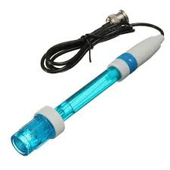
FURTHER DEVELOPMENT OF PROJECT:
By interfacing ML with IoT we can extend this Quality of Wine project by interfacing the Sensors like Alcohol ,pH ,Laser.
So by keeping some threshold values to the sensors we can store the data in the cloud and we can predict the Quality of Wine.

Slide 14
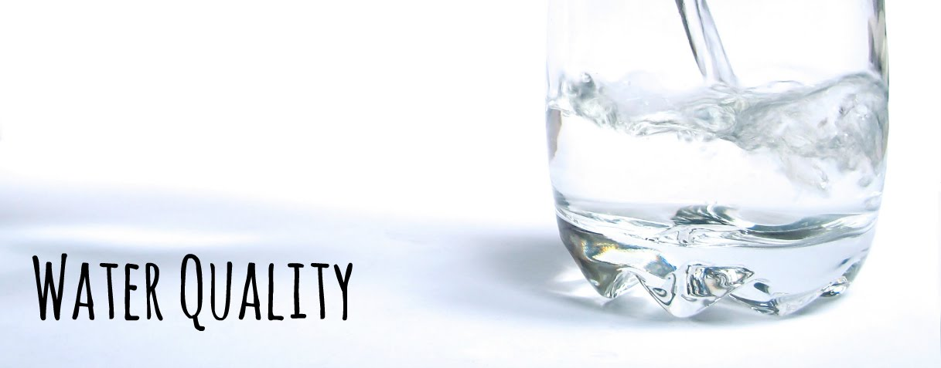
Similar Application

Slide 15
Parameters and sensors
The following parameters are to be evaluated for water and their corresponding sensors are used to read the parameters
Turbidity – turbidity sensor
Temperature – temperature sensor
Dissolved salts – Conductivity sensor
pH – pH sensor

